Slide 1
Live Data Feed Comparisons
 | FOREX | Twitter
API | Yes | Yes
Supported Languages | .Net \ JAVA | .Net \ JAVA \ Python \ …
Language Used | VB.Net | Python
Type of Connection | Streaming | Streaming
Data Structure | Object Oriented - Property Based | JSON
Highlights | Simple but very detailed with little supporting documentation - No working examples were available | Very simple to program - complete examples readily available

Slide 2
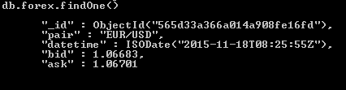
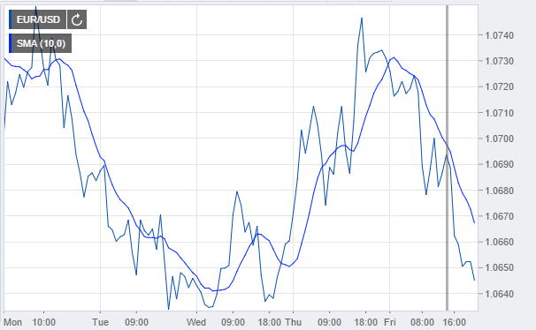

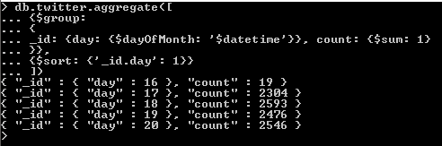
Load Data and Apply Rules
Buy and Hold: -$0.00127
Moving Average: -$0.00031
Random: $0.00192
Twitter: -$0.00085

Slide 3
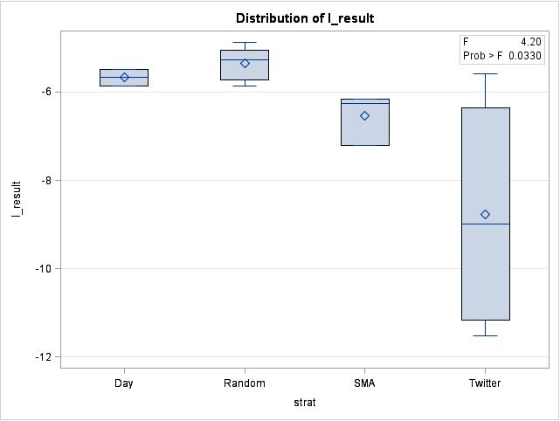
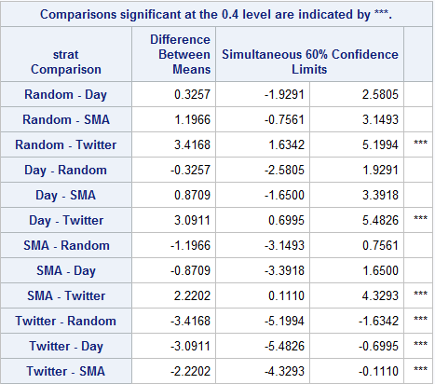
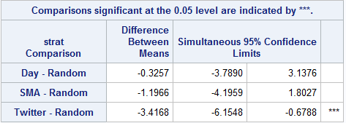
Statistical Analysis
Upper Left: Box plot of log P/L
Above: Sheffe’s method at alpha = 0.4
Left: Dunnett’s test alpha = 0.05

